Slide 1
Final Presentation of WDS Design
Amos - Hall - Nguyen

Slide 2
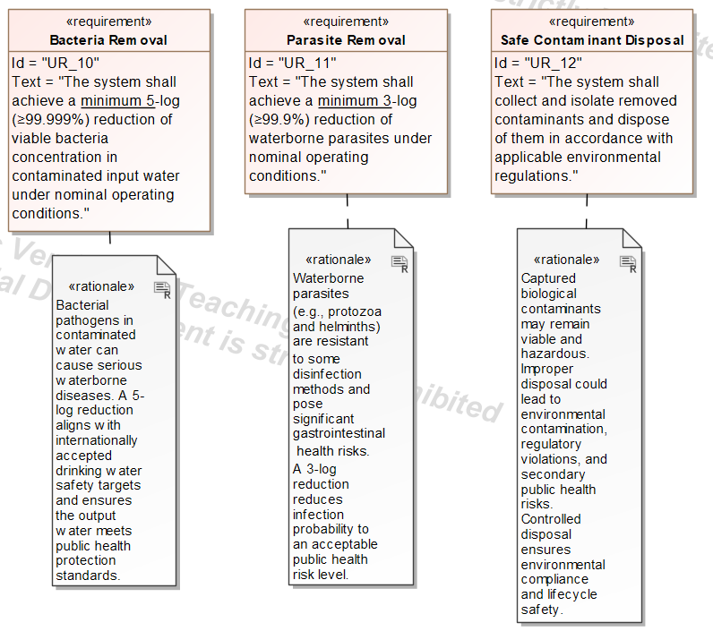
User Requirements
Bacteria removal for safe water.
Parasite removal to reduce infection risk.
Secure, regulation-compliant disposal of contaminants.

Slide 3
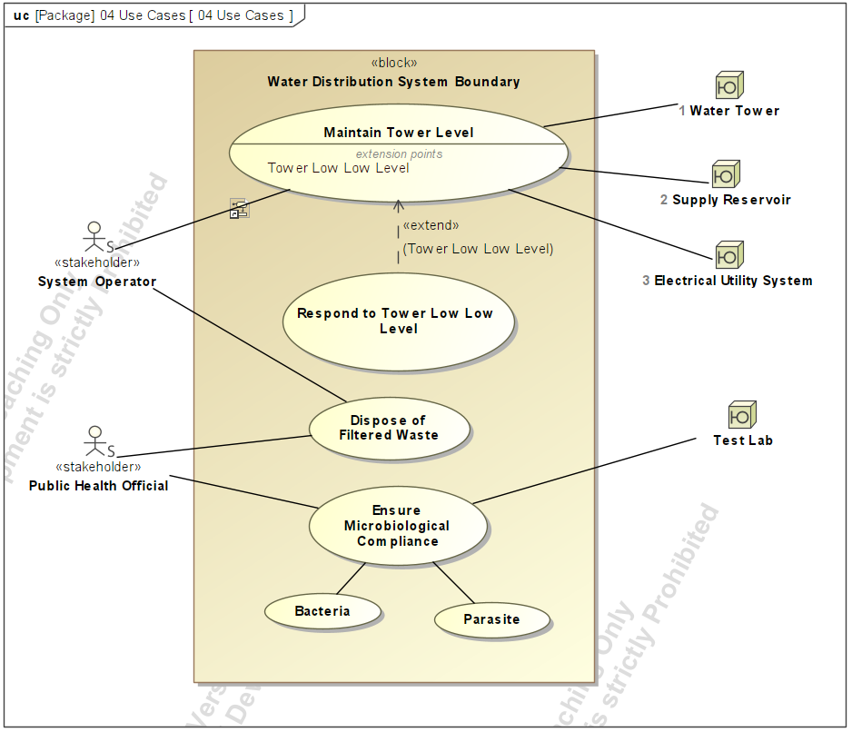
Use Cases
Safety & Public Health
Ensures water quality (bacteria & parasites)
Manages filtered waste with health authorities

Slide 4
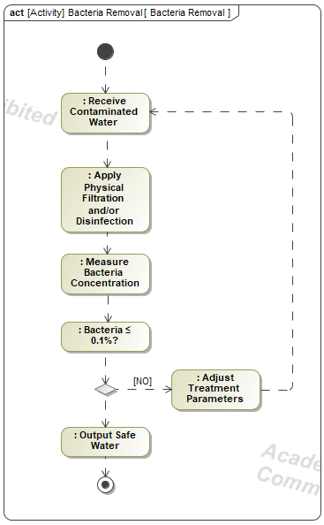
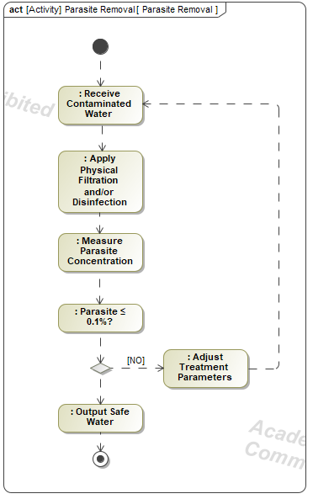
Filter Activity Diagrams

Slide 5
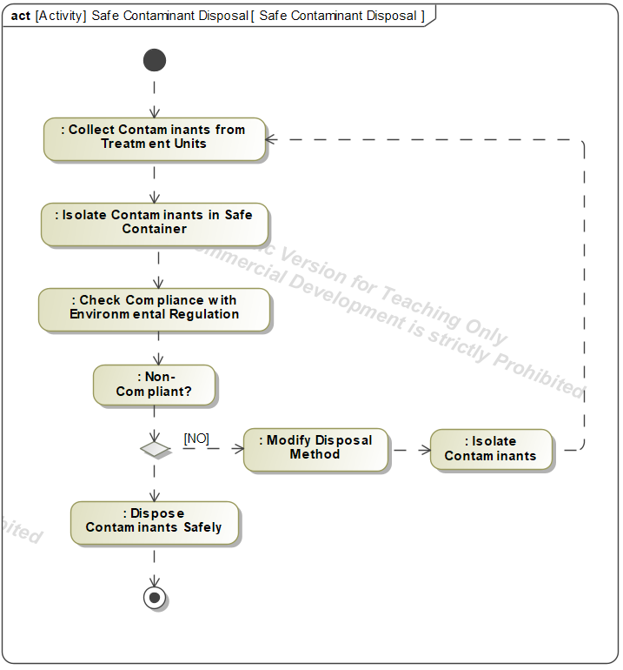
Contaminant Disposal Activity

Slide 6
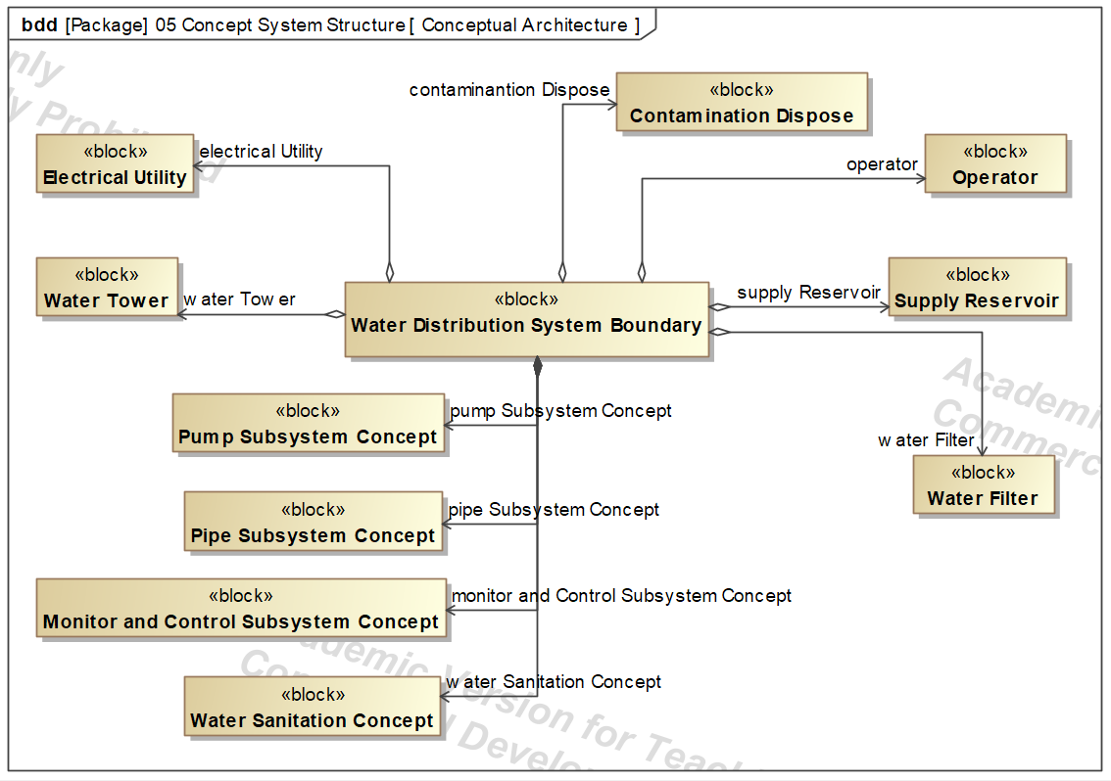
System Concept

Slide 7
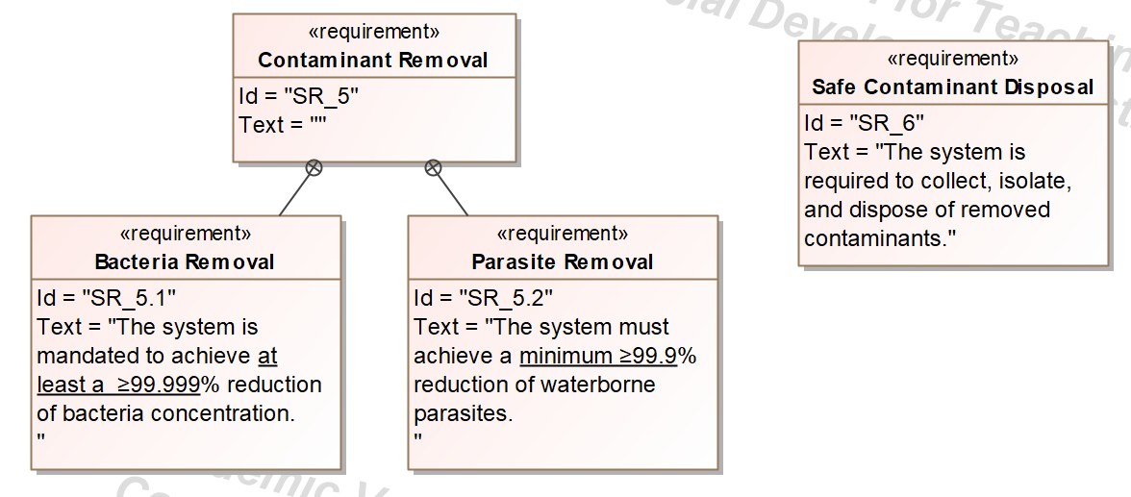
System Requirements

Slide 8
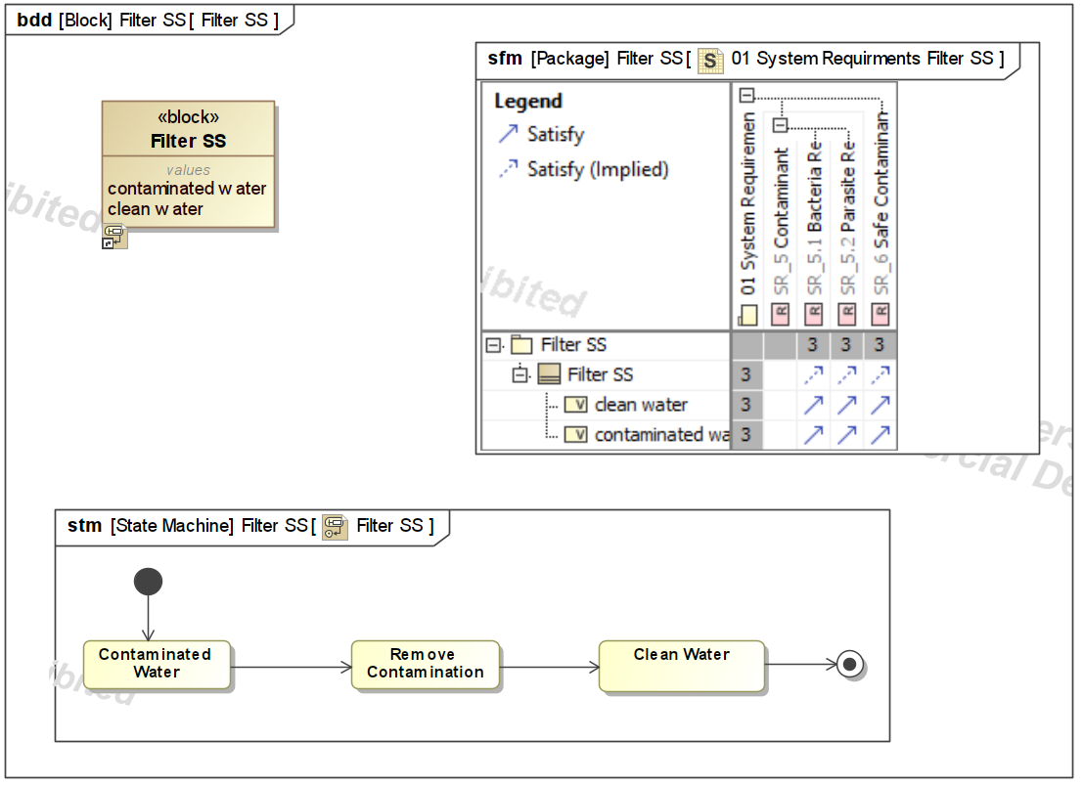
Filter Sub System

Slide 9
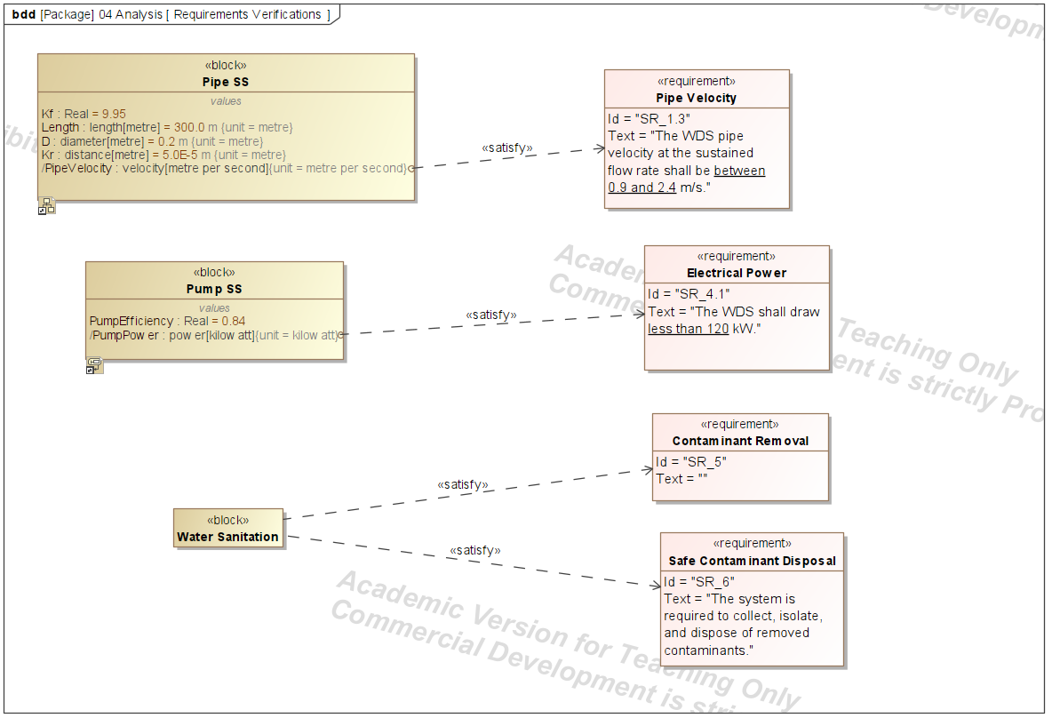
Satisfying Requirements

Slide 10
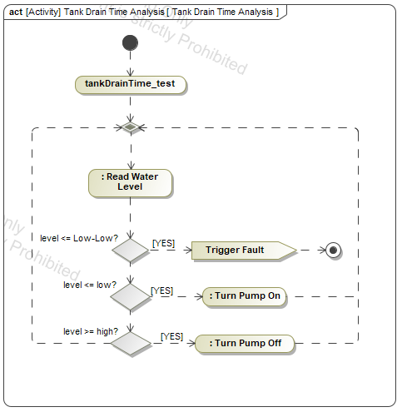
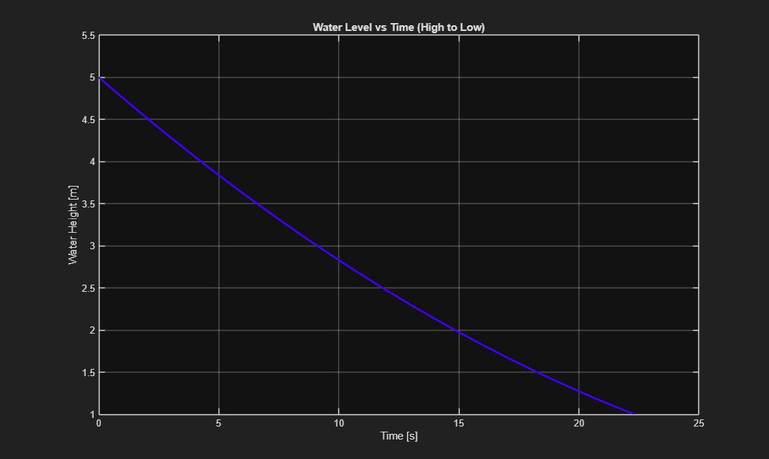
Tank Drain Analysis

